Slide 1
First Class Functions in Python
DVT101 – Lecture 16
- By Dataverse Tutorials

Slide 2
What Are First Class Functions?
Functions are treated as objects
Same behavior as variables
Core concept in Python
Foundation of functional programming

Slide 3
Why First Class Functions Matter
Code reusability
Clean and modular design
Enables decorators & callbacks
Widely used in Data Science

Slide 4
Characteristics of First Class Functions
Assign to variables
Pass as arguments
Return from functions
Store in data structures

Slide 5
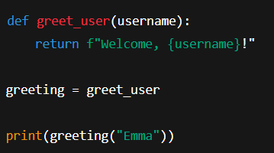
Assigning Function to Variable
Function reference is assigned
No execution during assignment
Variable behaves like function name

Slide 6
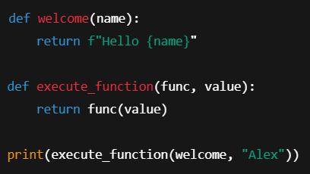
Passing Function as Argument
Functions can accept other functions
Enables higher-order functions
Common in callbacks & pipelines

Slide 7
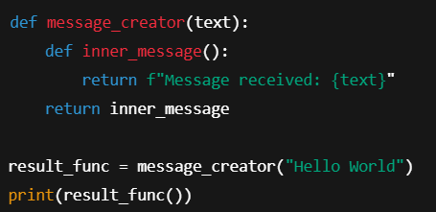
Returning Function from Function
Function creates another function
Closure concept involved
Used in decorators

Slide 8
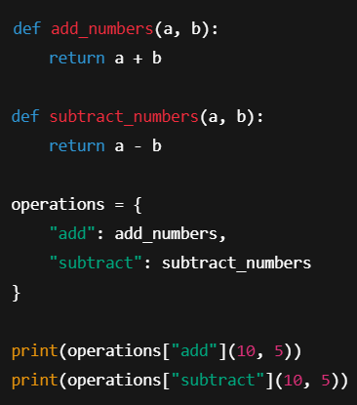
Storing Functions in Data Structures
Functions stored like values
Dynamic execution
Used in rule engines

Slide 9
Real-World & Industry Use Cases
Machine learning pipelines
Data transformations
Callbacks & event handlers
Decorators

Slide 10
Summary & Key Takeaways
Functions are objects
Can be passed, returned, stored
Core Python strength
Foundation for advanced concepts

Slide 11


